Slide 1
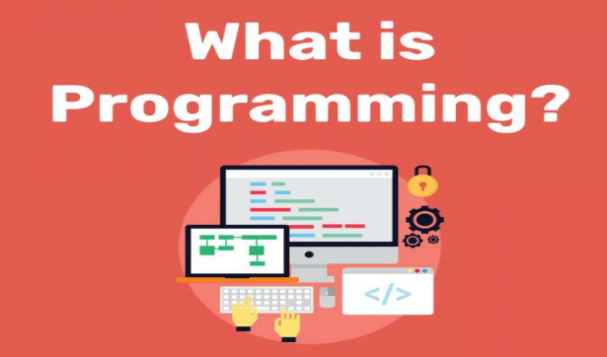
Unit 11.1 - Programming Basics
Prepared by: Koh Kian Hua

Slide 2
Objectives
After completing this unit, students should be able to:
Implement and write pseudocode from a given design presented as either a program flowchart or structured English
Write pseudocode statements for:
the declaration of variables and constants
the assignment of values to variables and constants
expressions involving any of the arithmetic or logical operators input from the keyboard and output to the console
Use built-in functions and library routines

Slide 3
Programming Basics
Introduction
Before writing a program that performs a specific task or solves a given problem, the problem needs to be designed and then coded.
This unit demonstrates the programming tools used when coding a solution, including basic statements, constructs and structures.

Slide 4
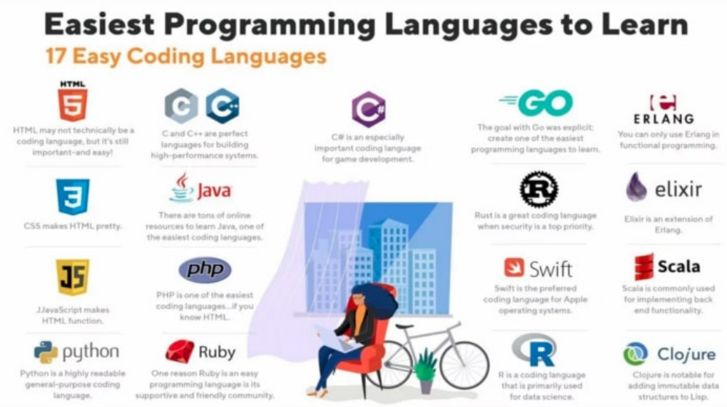
Programming Basics
Types of Programming Languages

Slide 5
Programming Basics
Python tutorial and installation guide
1. Python Installer Download
https://www.python.org/downloads/
2. Python Installer Guide
https://realpython.com/installing-python/
3) Python IDE (Integrated Development Environment)
Wing: https://www.wingware.com/downloads/wing-personal
Notepad++ : https://notepad-plus-plus.org/downloads/
4. Python Programming Tutorial
https://www.tutorialspoint.com/python/index.htm

Slide 6
Programming Basics
Contants and Varaiables
A constant is a named value that cannot change during the execution of a program.
A variable is a named value that can change during the execution of a program.
All variables and constants should be declared before use.
Constants will always be assigned a value when declared.
It is good practice to create an identifier list and check that every variable on that list has been declared and a value assigned.

Slide 7
Programming Basics
Programming Example
Write an algorithm using pseudocode to calculate and output the volume and surface area of a sphere for any radius that is input.
First, we create an identifier table:
Identifier Name | Description
radius | Stores radius input
volume | Stores result of volume calculation
surfaceArea | Stores result of surfacearea calculation
pi | Constant set to 3.142

Slide 8
Programming Basics
Programming Example (Pseudo Code)
//Declare constants and variables in pseudocode.
DECLARE radius : REAL
DECLARE volume : REAL
DECLARE surfaceArea : REAL
CONSTANT pi ← 3.142
OUTPUT "Please enter the radius of the sphere "
INPUT radius
//Check the value of the radius, to ensure that it is suitable.
WHILE radius <= 0 DO
OUTPUT "Please enter a positive number "
INPUT radius
ENDWHILE
//Calculate the volume and the surface area; this is the processing part of the algorithm.
volume ← (4 / 3) * pi * radius * radius * radius
surfaceArea ← 4 * pi * radius * radius
//Finally, the results of the calculations need to be output.
OUTPUT "Volume is ", volume
OUTPUT "Surface area is ", surfaceArea

Slide 9
Programming Basics
Contants and Variables
The table below shows the declaration of some of the constants and variables from three prescribed programming languages.
Declarations of Constants and Variables | Language
pi = 3.1412 | Python does not require any separate declarations and makes no difference between constants and variables.
Dim radius As Decimal Dim volume As Decimal Dim surfaceArea As Decimal Const pi As Decimal = 3.142 | In VB (Visual Basic), Constants can be explicitly typed as shown or implicitly typed, for example: Const pi = 3.142
final double PI = 3.142; : : double volume = (4 / 3) * PI * radius * radius * radius; | In Java, constant values are declared as variables with a final value so no changes can be made. These final variable names are usually capitalised to show they cannot be changed.

Slide 10
Programming Basics
Input Statements
The table below show examples of the input statements in the three prescribed programming languages..
Input Statements | Language
radius = float(input("Please enter the radius of the sphere ")) | Python combines the prompt with the input statement and the type of the input.
Console.Write("Please enter the radius of the sphere ") radius = Decimal.Parse(Console.ReadLine()) | VB uses a separate prompt and input. The input specifies the type.
import java.util.Scanner; : Scanner myObj = new Scanner(System.in); : System.out.println("Please enter the radius of the sphere "); double radius = myObj.nextDouble(); | In Java, the input library has to be imported at the start of the program and an input object is set up. Java uses a separate prompt and input. The input specifies the type and declares the variable of the same type.

Slide 11
Programming Basics
Checking Value
The table below show examples of how to check the value of the radius in each of the three programming languages.
Input Statements | Language
while radius <= 0: | Python uses a check at the start of the loop
Do : Loop Until radius > 0 | VB uses a check at the end of the loop
do { : } while (radius <= 0); | Iava uses a check at the end of the loop

Slide 12
Programming Basics
Calculate Volume & Surface Area
The table below show examples of how to calculate the volume and the surface area in each of the three programming languages.
Calculate Volume & SurfaceArea | Language
volume = (4 / 3) * pi * radius * radius * radius surfaceArea = 4 * pi * radius * radius | Python
volume = (4 / 3) * pi * radius * radius * radius surfaceArea = 4 * pi * radius * radius | VB
double volume = (4 / 3) * PI * radius * radius * radius; double surfaceArea = 4 * PI * radius * radius; | Java

Slide 13
Programming Basics
Outputting the Results
The table below show examples of how to output the results in each of the three programming languages.
Output the Results | Language
print("Volume is ", volume) print("Surface area is ", surfaceArea) | Python uses a comma
Console.WriteLine("Volume is " & volume) Console.WriteLine ("Surface area is " & surfaceArea) | VB uses &
System.out.println("Volume is " + volume); System.out.println("Surface area is " + surfaceArea); | Java uses +

Slide 14
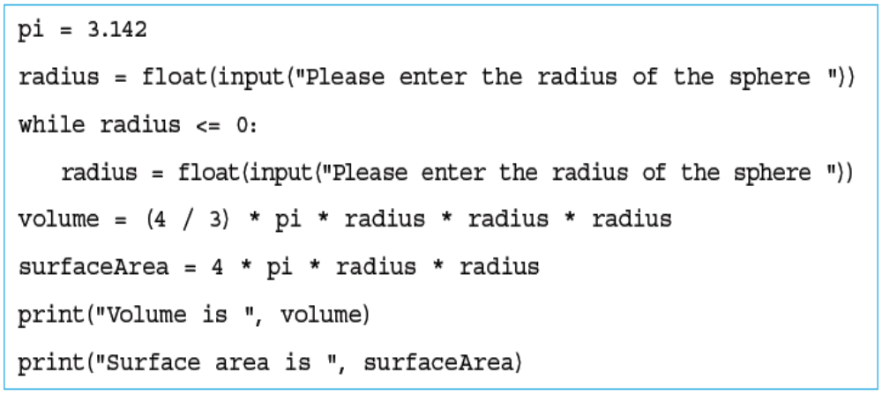
Programming Basics
Program Source Code In Python
The complete program in Python is shown below.

Slide 15
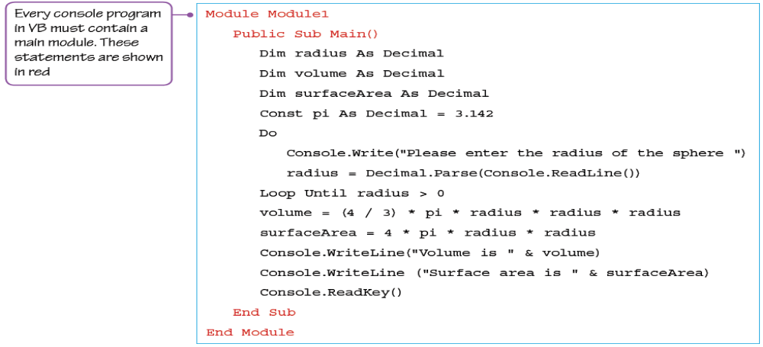
Programming Basics
Program Source Code In VB (Visual Basic)
The complete program in VB is shown below.

Slide 16
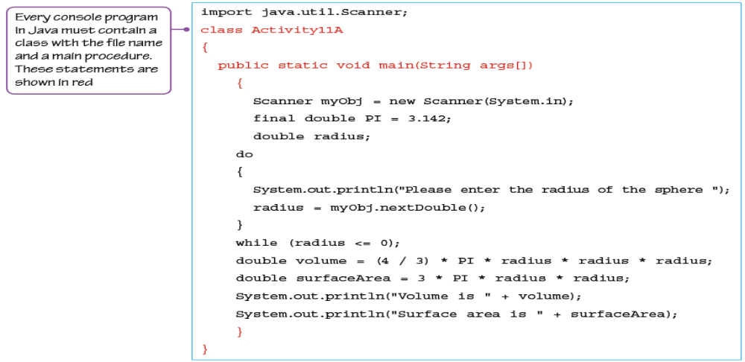
Programming Basics
Program Source Code In Java
The complete program in Java is shown below.

Slide 17
Programming Basics
String Manipulation Functions
The table shows the string manipulation functions for the three prescribed programming languages.
String Manipulation Functions | Language
len(inputPassword) inputPassword[0] inputPassword[-1:] | Python first character of string last character of string
Len(inputPassword) Left(inputPassword, 1) Right(inputPassword, 1) | VB first character of string last character of string
int size =inputPassword.length(); inputPassword.charAt(0) inputPassword.charAt(size - 1) | Java first character of string last character of string

Slide 18
Programming Basics
String Manipulation Question
Write an algorithm using pseudocode to check that the length of a password and the first and last letter of a password input is correct.
You can use these string manipulation functions:
LENGTH(anyString : STRING) RETURNS INTEGER returns the integer value
representing the length of anyString.
RIGHT(anyString: STRING, x : INTEGER) RETURNS STRING returns
rightmost x characters from anyString.
LEFT(anyString: STRING, x : INTEGER) RETURNS STRING returns
leftmost x characters from anyString.
MID(anyString: STRING, x : INTEGER, y : INTEGER) RETURNS STRING returns y characters starting at position x from anyString.

Slide 19
Programming Basics
Solution
First, we create an indentifier table.
Identifier Name | Description
storedPassword | Stores password
inputPassword | Stores password to be checked
size | Stores length of password to be checked

Slide 20
Programming Basics
Solution
Second, we write the Pseudo Code.
CONSTANT storedPassword ← "Secret"
DECLARE inputPassword : STRING
DECLARE size : INTEGER
OUTPUT "Please enter your password "
INPUT inputPassword
size ← LENGTH(inputPassword)
IF size = LENGTH(storedPassword)
THEN
IF (LEFT(inputPassword, 1) = LEFT(storedPassword, 1)) AND (RIGHT(inputPassword, 1) = RIGHT(storedPassword, 1))
THEN
OUTPUT "Password entered has correct first and last letters"
ELSE
OUTPUT "Password entered is incorrect"
ENDIF
ELSE
OUTPUT "Password entered is incorrect"
ENDIF

Slide 21
Programming Basics
Class Activity
What is the diffrence between a constant and a variable ?
Wtite Pseudo Code to create a string called name and sets it to "Bob", and count how many characters are in that string and stores the answer (3) into a variable called namecharcount
Convert the Pseudo code that you have written above in Q2 to Python code.

